Slide 1
Spam Email Classifier
Submitted to: Submitted By:
Mr. NITIN YASH RAJ
101511069

Slide 2
NLTK used for
Tokenizing words
Lemmatizing words
Removing stop words from the training data
Using Naïve Bayes Classifier for classification purposes

Slide 3
Code:
import nltk
import os
import random
from nltk import word_tokenize, WordNetLemmatizer
from nltk.corpus import stopwords
from nltk import NaiveBayesClassifier, classify
stoplist = stopwords.words('english')
def get_data(folder):
a = []
files = os.listdir(folder)
for file in files:
f = open(folder + file, 'r', encoding = "ISO-8859-1") ## cause there are some latin words also
a.append(f.read())
f.close()
return a
Necessary imports
Creating list of stop words from English language
Reading all the files

Slide 4
`
takes sentence as parameter and lemmatize it word by word
def preprocess(sentence):
lemmatizer = WordNetLemmatizer()
return [lemmatizer.lemmatize(word.lower()) for word in word_tokenize(sentence)]
def getfeatures(text): #creating feature list
return {word: True for word in preprocess(text) if not word in stoplist}
def print_accuracy(train_set, test_set, classifier): #finding accuracy of the training and testing data
print ('Accuracy on the training set = ' + str(classify.accuracy(classifier, train_set)))
print ('Accuracy of the test set = ' + str(classify.accuracy(classifier, test_set)))
classifier.show_most_informative_features(10)

Slide 5
def train(features, samples_proportion):
train_size = int(len(features) * samples_proportion)
train_set, test_set = features[:train_size], features[train_size:]
print ('Training set size = ' + str(len(train_set)) + ' emails')
print ('Test set size = ' + str(len(test_set)) + ' emails')
classifier = NaiveBayesClassifier.train(train_set)
return train_set, test_set, classifier
#finds index of data at 80%
#defining training and #testing data
#training using naïve Bayes #classifier

Slide 6
if __name__ == "__main__":
spam = get_data('enron1/spam/') #reads spam emails
ham = get_data('enron1/ham/') #reads ham emails
allemails = [(email, 'spam') for email in spam] #creating a list of tuples having email
allemails += [(email, 'ham') for email in ham] with its label
random.shuffle(allemails) #shuffling the list to randomly distribute
training and testing data
print (str(len(allemails)) + ' emails')
allfeatures = [(getfeatures(email), label) for (email, label) in allemails] #learning features
print (str(len(allfeatures)) + ' feature sets') from the data
train_set, test_set, classifier = train(allfeatures, 0.8) #defining size of training ,testing data
print_accuracy(train_set, test_set, classifier)

Slide 7
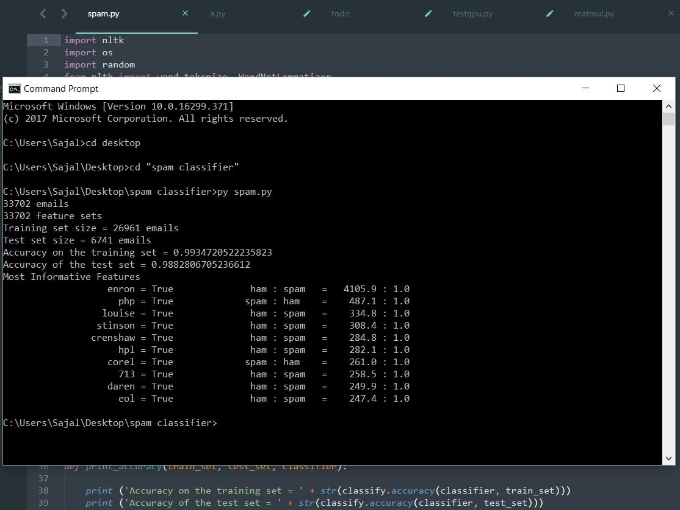
Result

